Slide 1

Psychopharmacology: Drugs, the Brain, and Behavior
by Meyer, Farrar, Biezonski, Yates

Slide 2
Chapter 7
Acetylcholine
7.1 Acetylcholine Synthesis, Release, and Inactivation
7.2 Organization and Function of the Cholinergic System

Slide 3
Chapter 7
Learning Objectives (1 of 2)
7.1.1 (a) Name the chemical precursors needed for ACh synthesis and the enzyme that catalyzes the synthetic reaction, and (b) describe the processes that regulate the rate of ACh synthesis.
7.1.2 Name and describe the effects of drugs and toxins that affect ACh vesicular storage and release. These effects should include medical or cosmetic uses where appropriate.
7.1.3 (a) Describe the main molecular forms of acetylcholinesterase (AChE), the cellular localization of each form, and the role of this enzyme in ACh breakdown, and (b) list the drugs known to block AChE and for each one, identify its medical or other use.
7.1.4 Discuss the clinical disorders associated with abnormal cholinergic transmission at the neuromuscular junction, including the symptoms of these disorders and their pharmacological treatment.

Slide 4
Chapter 7
Learning Objectives (2 of 2)
7.2.1 Identify the locations of cholinergic neurons in both the peripheral nervous system and the brain.
7.2.2 Discuss evidence for a role of various cholinergic systems in (a) motor control, including abnormalities in motor control in Parkinson’s disease, (b) memory encoding, (c) sustained attention, and (d) drug reward and reinforcement.
7.2.3 (a) Identify and characterize the two major cholinergic receptor subtypes, including their subunit structure (where relevant) and signaling mechanisms, (b) discuss the major behavioral functions of cholinergic receptors, and (c) list the major agonists and antagonists at these receptors and their behavioral or physiological effects.
7.2.4 Describe the three different states of nicotinic receptors and how they are regulated.

Slide 5
Acetylcholine Synthesis, Release, and Inactivation (1 of 10)
Acetylcholine synthesis is catalyzed by the enzyme choline acetyltransferase
Acetylcholine (ACh; adjective form, cholinergic); synthesized in one step from choline and acetyl coenzyme A (acetyl CoA), catalyzed by choline acetyltransferase (ChAT)
ChAT is found only in neurons that use ACh as a transmitter.
Rate of synthesis depends on availability of precursors and rate of cell firing; there are no inhibitors of ChAT
Notes:
Instructor Notes:

Slide 6
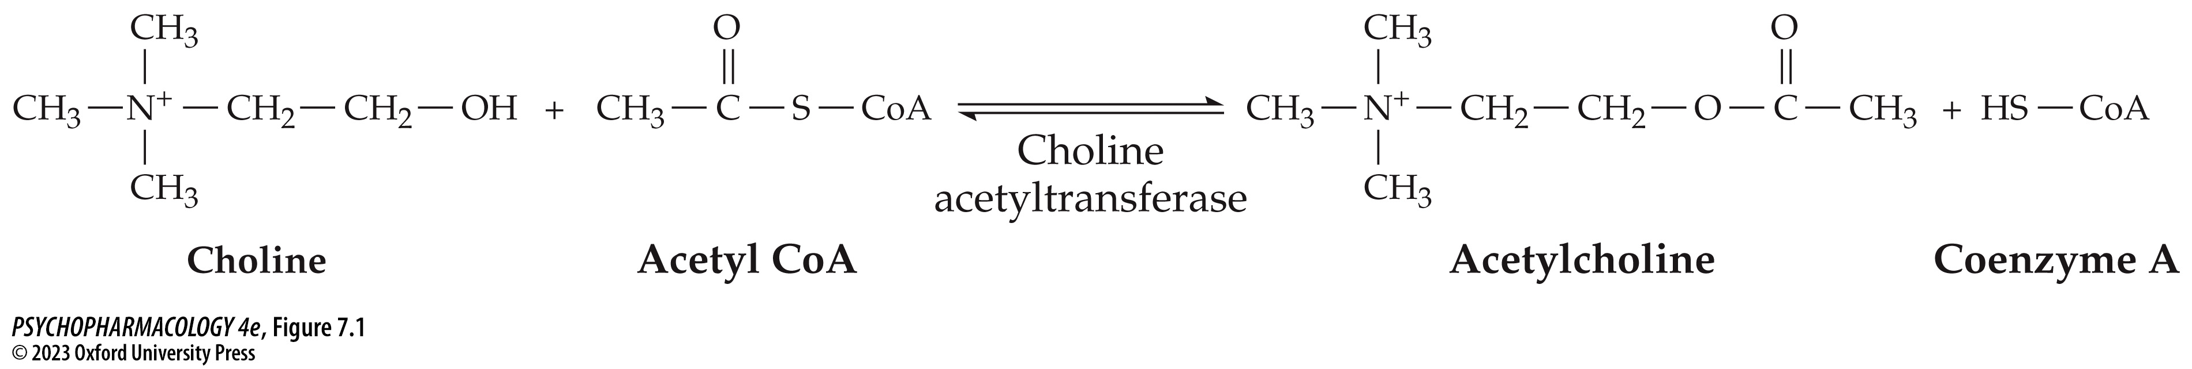
FIGURE 7.1 Synthesis of acetylcholine (ACh) by choline acetyltransferase
Notes:
FIGURE 7.1 Synthesis of acetylcholine (ACh) by choline acetyltransferase

Slide 7
Acetylcholine Synthesis, Release, and Inactivation (2 of 10)
Many different drugs and toxins can alter acetylcholine storage and release
ACh is loaded into synaptic vesicles by vesicular ACh transporters (VAChT)
VAChT can be blocked by vesamicol – reduces amount of ACh released when neurons fire.
Notes:
Instructor Notes:

Slide 8
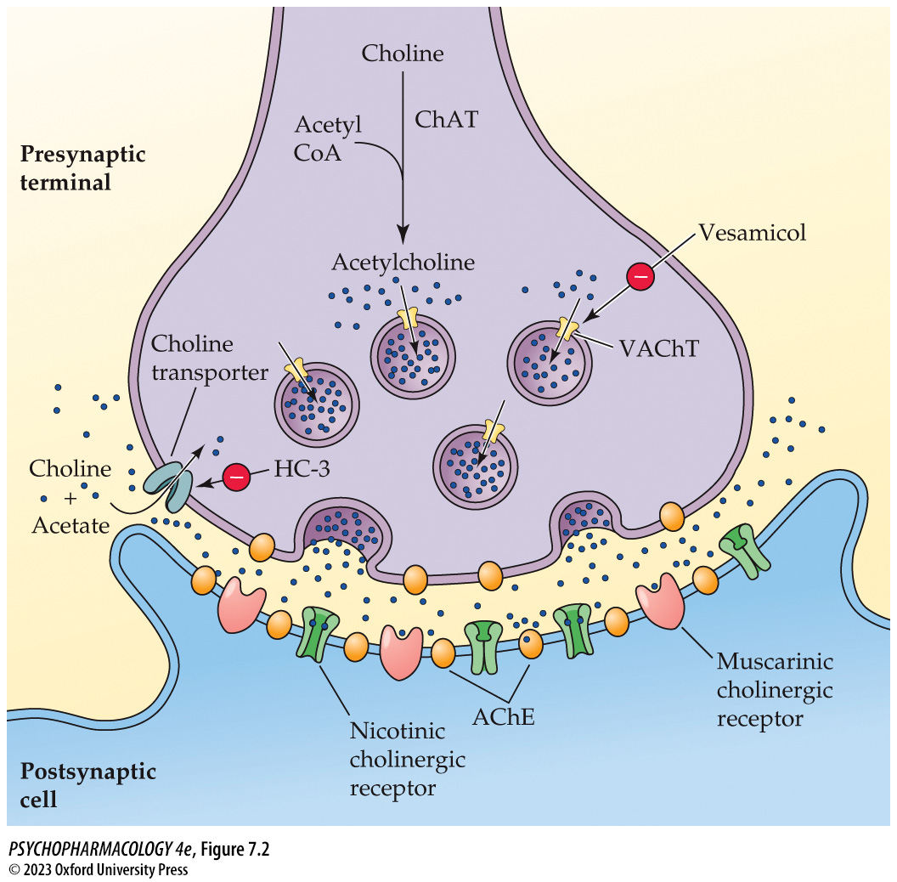
FIGURE 7.2 A cholinergic synapse
Notes:
FIGURE 7.2 A cholinergic synapse
The processes of ACh synthesis and metabo­lism, presynaptic choline uptake, and vesicular ACh uptake and release occur at the synapse. Postsynaptic nicotinic and muscarinic ACh receptors are also shown. AChE, acetylcholinesterase; ChAT, choline acetyltransferase; HC-3, the drug hemicholinium-3; VAChT, vesicular ACh transporter.

Slide 9
Acetylcholine Synthesis, Release, and Inactivation (3 of 10)
Many different drugs and toxins can alter acetylcholine storage and release
Ach release is affected by toxins
Black widow spider venom causes massive release of ACh in the PNS
Botulism toxin blocks ACh release by preventing fusion of synaptic vesicles with nerve terminal membrane; causes muscular paralysis
Notes:
Instructor Notes:

Slide 10
Acetylcholine Synthesis, Release, and Inactivation (4 of 10)
BOX 7.1 PHARMACOLOGY IN ACTION
Botulinum Toxin—Deadly Poison, Therapeutic Remedy, and Cosmetic Aid
Botulinum toxins A through G are produced by the anaerobic bacterium Clostridium botulinum
The toxin proteins are taken up selectively by peripheral cholinergic nerve terminals, including at the neuromuscular junction, and fibers innervating smooth muscle and secretory glands
Toxins are used in treating disorders characterized by involuntary muscle contractions, as a pain reliever, and cosmetically (Botox)
Notes:
Instructor Notes:
sdsdfsd

Slide 11
Acetylcholine Synthesis, Release, and Inactivation (5 of 10)
Acetylcholinesterase is responsible for acetylcholine breakdown
Acetylcholinesterase (AChE) breaks ACh down to choline and acetic acid; four subunits combine to form a tetramer (G4)
Three forms of AChE:
  Soluble: free G4 in the cell
  G4 tethered to the cell membrane – in a position to allow rapid breakdown
  A12 – at neuromuscular junctions; 12 subunits; very rapid breakdown of Ach allows muscle to relax before next contraction
Notes:
Instructor Notes:

Slide 12
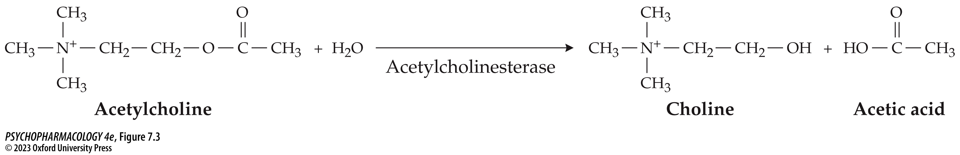
FIGURE 7.3 Breakdown of ACh by acetylcholinesterase
Notes:
FIGURE 7.3 Breakdown of ACh by acetylcholinesterase

Slide 13
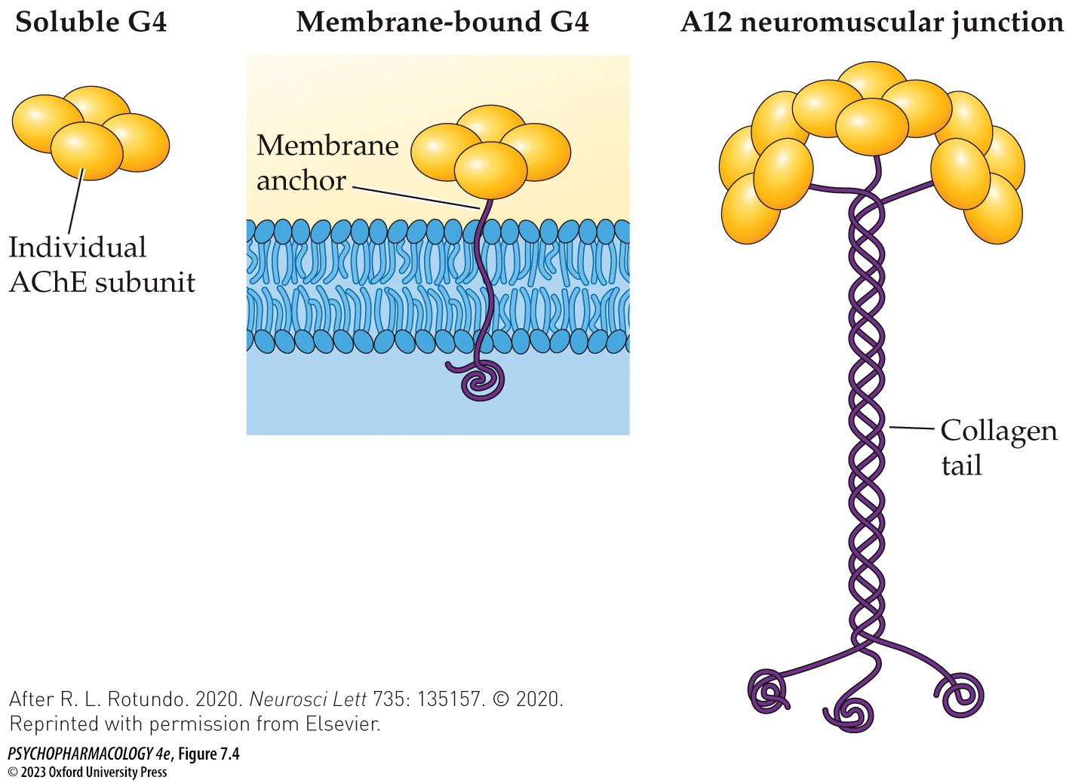
FIGURE 7.4 Forms of acetylcholinesterase in the nervous system
Notes:
FIGURE 7.4 Forms of acetylcholinesterase in the nervous system
Three main forms of AChE occur within the brain and peripheral nervous system. Cholinergic neurons and postsynaptic neurons that receive ACh input synthesize the G4 forms of the enzyme. Most of the G4 AChE is bound to the cell membrane by a tail, as shown. At the neuromuscular junction, muscle cells synthesize the A12 form of AChE that possesses a collagen tail. This form is secreted into the neuromuscular junction, where the collagen tail anchors it to the extracellular matrix. (After R. L. Rotundo. 2020. Neurosci Lett 735: 135157. © 2020. Reprinted with permission from Elsevier.)

Slide 14
Acetylcholine Synthesis, Release, and Inactivation (6 of 10)
Acetylcholinesterase is responsible for acetylcholine breakdown
Choline is taken back up by choline transporters; transporters can be blocked by hemicholinium-3 (HC-3) – ACh production declines.
Drugs that block AChE prevent breakdown of ACh; ACh effects increase – useful for disorders in which cholinergic transmission is deficient, but can be toxic or fatal
AChE reversible inhibitors donepezil (Aricept), rivastigmine (Exelon), and galantamine (Reminyl) are used in treatment of age-related dementia
Notes:
Instructor Notes:

Slide 15
Acetylcholine Synthesis, Release, and Inactivation (7 of 10)
Acetylcholinesterase is responsible for acetylcholine breakdown
Physostigmine (eserine): reversible AChE inhibitor that crosses blood-brain barrier and affects the CNS; used for glaucoma (applied directly to eyes) but toxic if given systemically.
Organophosphorus compounds: irreversible AChE inhibitors; used as insecticides; “nerve gasses” are more toxic versions, such as sarin and soman.
Troops in Iraq were given the reversible AChE inhibitor pyridostigmine as a nerve gas antidote: temporary interaction of pyridostigmine with the enzyme protects AChE from permanent inactivation
Notes:
Instructor Notes:

Slide 16
Acetylcholine Synthesis, Release, and Inactivation (8 of 10)
Several neuromuscular disorders are associated with abnormal cholinergic functioning at the neuromuscular junction
Myasthenia gravis: autoimmune disorder in which antibodies against muscle cholinergic receptors are produced; leads to severe muscle weakness and fatigue
Treated with Neostigmine (Prostigmin) and pyridostigmine (Mestinon) – synthetic analogs of physostigmine that don’t cross the blood-brain barrier
Notes:
Instructor Notes:

Slide 17
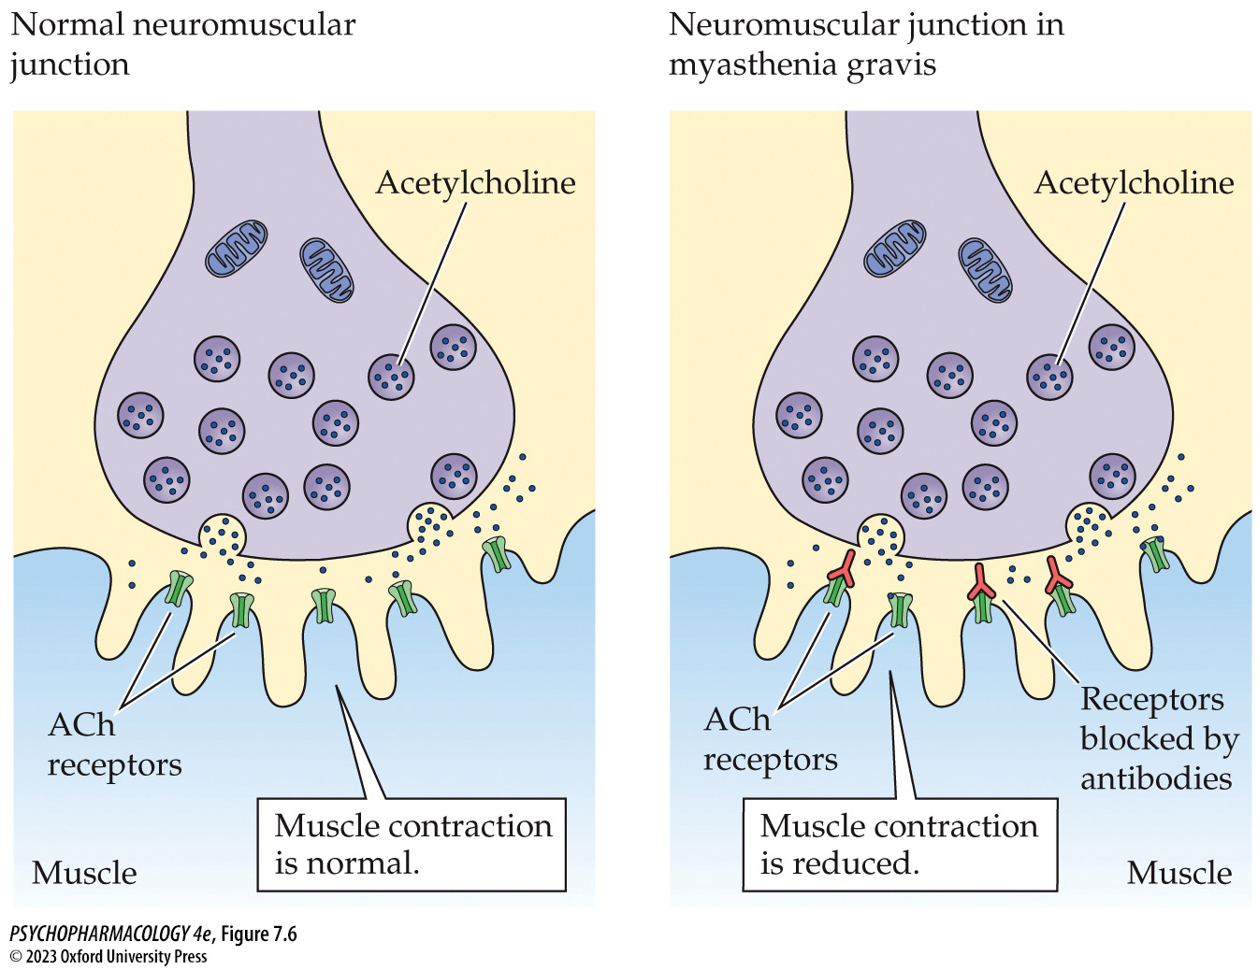
FIGURE 7.6 Myasthenia gravis, an autoimmune disorder (1)
Notes:
FIGURE 7.6 Myasthenia gravis, an autoimmune disorder
In myasthenia gravis, antibodies interfere with cholinergic transmission at the neuromuscular junction by binding to and blocking the muscle ACh receptors.

Slide 18
Acetylcholine Synthesis, Release, and Inactivation (9 of 10)
Acetylcholinesterase is responsible for acetylcholine breakdown
Myasthenic syndromes result from mutations in genes that encode ChAT or AChE
Low ChAT: insufficient amounts of ACh are released at the neuromuscular junction
Deficient AChE: persistently elevated levels of ACh at neuromuscular junctions lead to desensitization of receptors and reduced cholinergic transmission
Notes:
Instructor Notes:

Slide 19
Acetylcholine Synthesis, Release, and Inactivation (10 of 10)
CLICKER QUESTION 1
Which chemical could be used to identify the location of cholinergic neurons?
Acetylcholinesterase
Acetyl coenzyme A
Choline acetyltransferase
Vesamicol
Notes:
Instructor Notes:
Correct answer: c

Slide 20
Review of Learning Objectives (1 of 2)
7.1.1 (a) Name the chemical precursors needed for ACh synthesis and the enzyme that catalyzes the synthetic reaction, and (b) describe the processes that regulate the rate of ACh synthesis.
7.1.2 Name and describe the effects of drugs and toxins that affect ACh vesicular storage and release. These effects should include medical or cosmetic uses where appropriate.
7.1.3 (a) Describe the main molecular forms of acetylcholinesterase (AChE), the cellular localization of each form, and the role of this enzyme in ACh breakdown, and (b) list the drugs known to block AChE and for each one, identify its medical or other use.
7.1.4 Discuss the clinical disorders associated with abnormal cholinergic transmission at the neuromuscular junction, including the symptoms of these disorders and their pharmacological treatment.

Slide 21
Organization and Function of the Cholinergic System (1 of 15)
Cholinergic neurons play a key role in the functioning of both the peripheral and central nervous systems
Preganglionic neurons of both branches of the autonomic nervous system are cholinergic, as are the ganglionic neurons of the parasympathetic system
Norepinephrine is the transmitter of the sympathetic ganglionic neurons
Notes:
Instructor Notes:

Slide 22
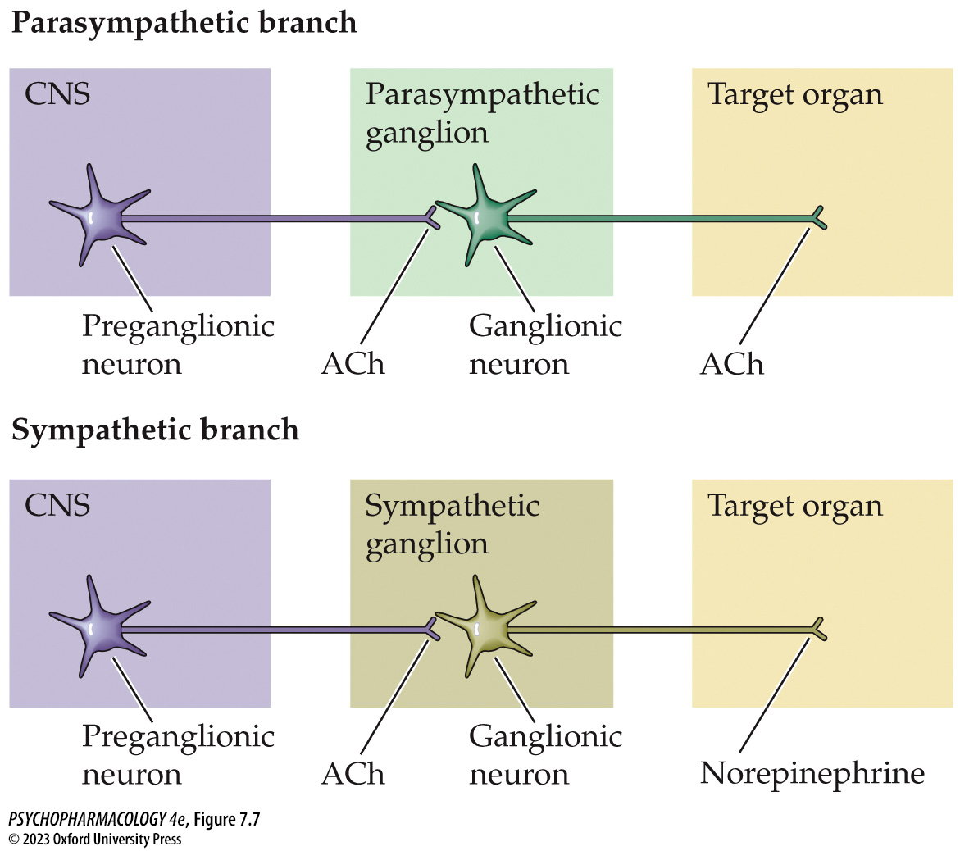
FIGURE 7.7 Cholinergic synapses in the parasympathetic and sympathetic branches of the autonomic nervous system
Notes:
FIGURE 7.7 Cholinergic synapses in the parasympathetic and sympathetic branches of the autonomic nervous system

Slide 23
Organization and Function of the Cholinergic System (2 of 15)
Cholinergic neurons play a key role in the functioning of both the peripheral and central nervous systems
In the brain, cell bodies of cholinergic neurons are clustered in only a few areas.
Interneurons in the striatum: regulation of movement depends in part on the balance between ACh and dopamine (DA).
In Parkinson’s disease, low DA levels cause transmitter imbalance; anticholinergic drugs may be used for treatment.
Notes:
Instructor Notes:
Anticholinergic drugs used in Parkinson’s: orphenadrine (Norflex), benztropine mesylate (Cogentin), trihexyphenidyl (Artane), procyclidine (Kemadrin), and biperiden (Akineton)

Slide 24
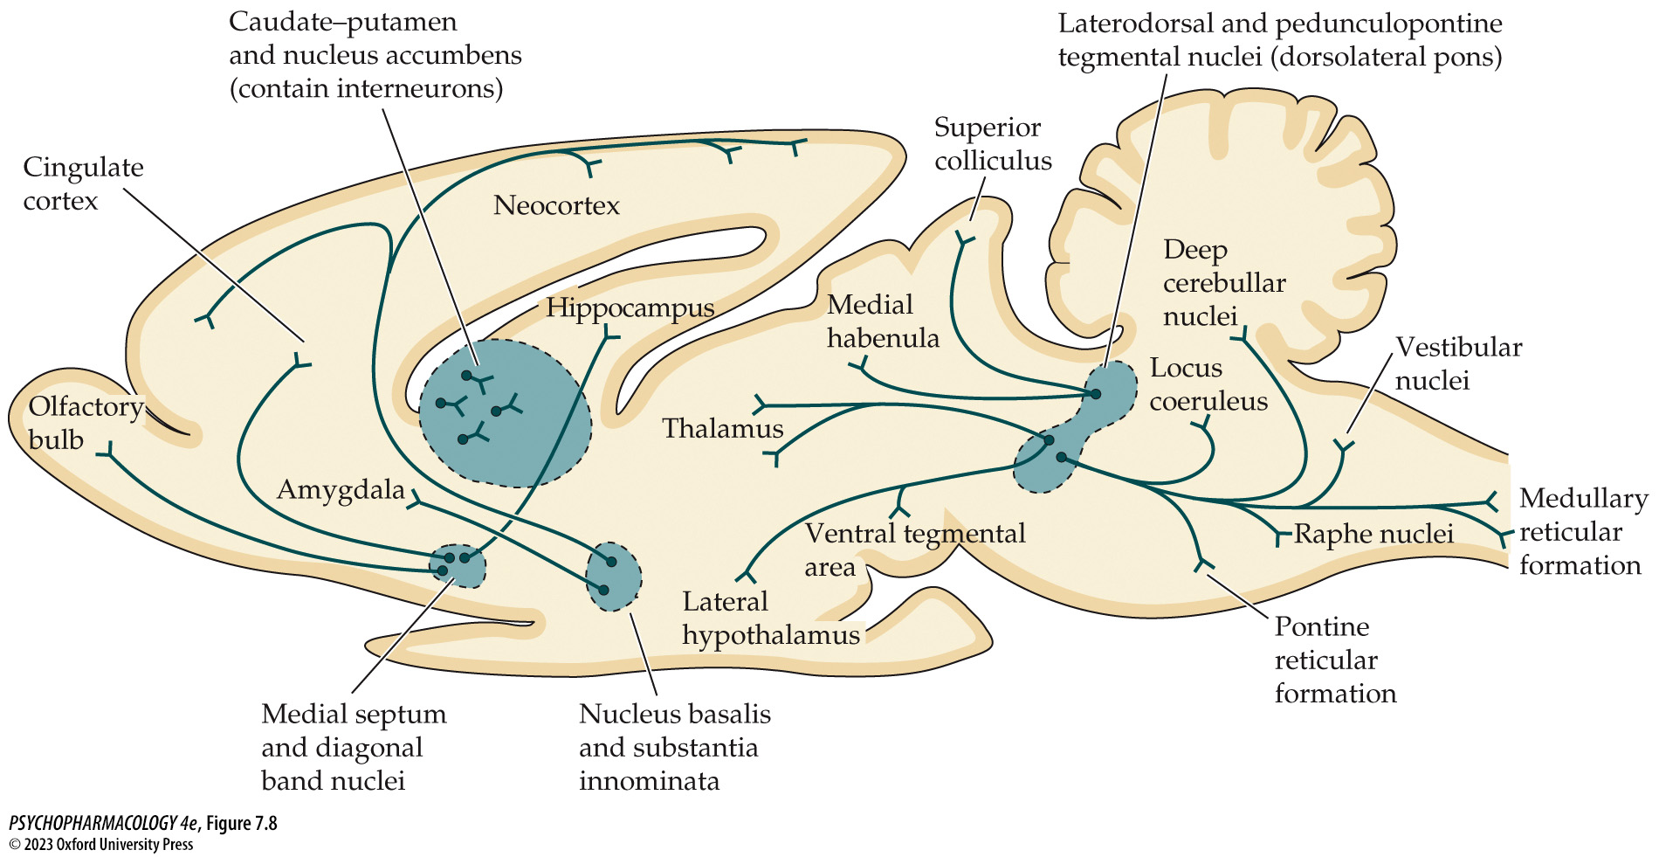
FIGURE 7.8 Anatomy of cholinergic pathways in the brain
Notes:
FIGURE 7.8 Anatomy of cholinergic pathways in the brain
The cell bodies of cholinergic neurons are located primarily in the caudate–putamen, nucleus accumbens, nucleus basalis/substantia innominata, medial septum, diagonal band nuclei, pedunculopontine tegmental nucleus, and dorsolateral tegmental nucleus. Note that the basal forebrain cholinergic cell groups send fibers to all areas of the cortex, as well as to limbic system structures such as the hippocampus and amygdala. Cell groups of the pedunculopontine tegmental and dorsolateral tegmental nuclei primarily innervate subcortical structures except for those that (a) receive input from the basal forebrain system, and (b) contain cholinergic interneurons (i.e., caudate–putamen, and nucleus accumbens).

Slide 25
Organization and Function of the Cholinergic System (3 of 15)
Cholinergic neurons play a key role in the functioning of both the peripheral and central nervous systems
Basal forebrain cholinergic system (BFCS): neurons in several brain areas; origin of cholinergic innervation of the cerebral cortex, hippocampus, and other limbic system structures.
Different components of the BFCS have different roles in cognition
Notes:
Instructor Notes:

Slide 26
Organization and Function of the Cholinergic System (4 of 15)
BOX 7.2 THE CUTTING EDGE
Acetylcholine and Cognitive Function
Cholinergic projections from the medial septum and diagonal band to the hippocampus are involved in encoding of declarative memories
Projections from the nucleus basalis/substantia innominata to the prefrontal cortex are important for maintaining sustained attention.
Optogenetic experiments in mice show that bursts of ACh release from BFCS neurons play a key role in detecting and responding to learned sensory cues.
Notes:
Instructor Notes:

Slide 27
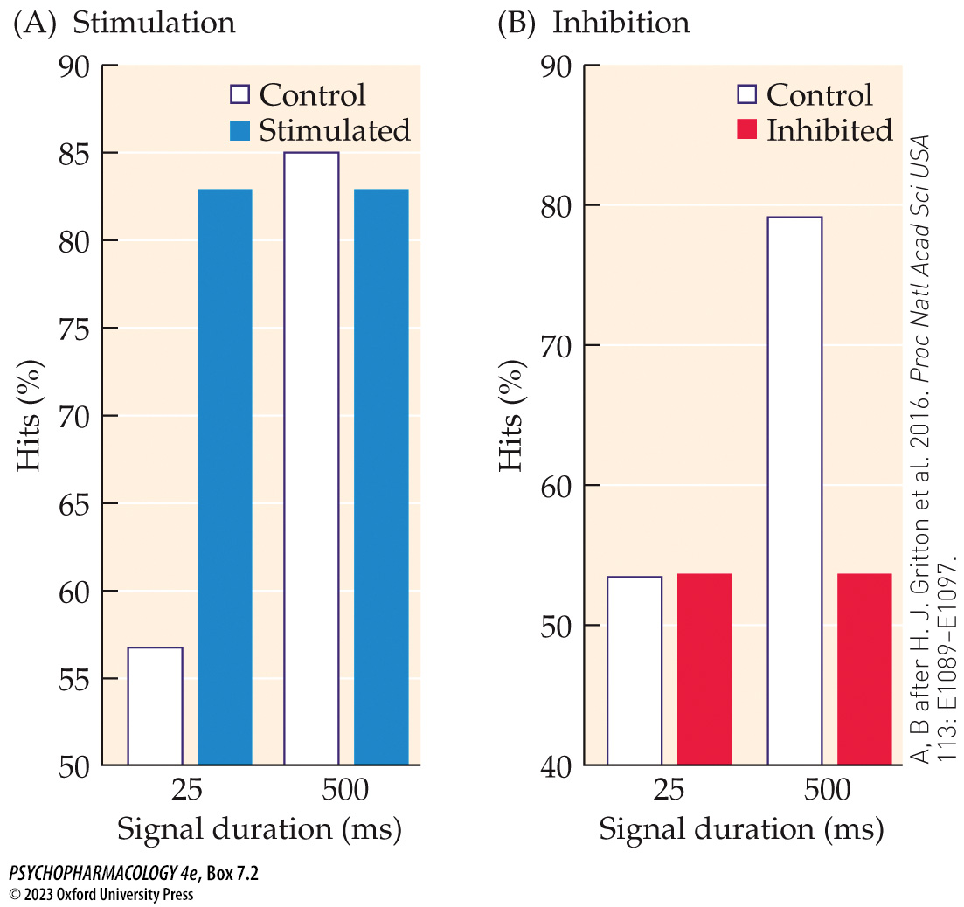
Box 7.2 The Cutting Edge: Acetylcholine and Cognitive Function
Notes:
Box 7.2 The Cutting Edge: Acetylcholine and Cognitive Function
Effects of optogenetic stimulation or inhibition of BFCS cholinergic neurons on visual cue detection
(A) Mice exposed to a short-duration (25 ms) or long-duration (500 ms) visual cue (light flash) reported whether they detected the cue by performing a nose-poke response. The open bars show control performance that consisted of a low hit rate associated with the short cue and a high hit rate associated with the long cue. The solid blue bars show that optogenetic stimulation of the BFCS cholinergic neurons increased the hit rate to the short cue but had no effect on the hit rate to the long cue. (B) The open bars show results from the same control conditions as in (A). The solid red bars show performance associated with optogenetic inhibition of the cholinergic neurons. In this case, inhibition of the cells diminished the hit rate to the long cue but had no effect on the hit rate to the short cue. (A, B after H. J. Gritton et al. 2016. Proc Natl Acad Sci USA 113: E1089–E1097.)

Slide 28
Organization and Function of the Cholinergic System (5 of 15)
Cholinergic neurons play a key role in the functioning of both the peripheral and central nervous systems
Cholinergic neurons in the laterodorsal and pedunculopontine tegmental nuclei (LDTg and PPTg) project to the basal ganglia and thalamus; others to the lower brainstem and spinal cord
Have multiple roles, including stimulation of midbrain dopamine neurons (important for drug reward and reinforcement) and initiation of REM sleep.
Notes:
Instructor Notes:

Slide 29
Organization and Function of the Cholinergic System (6 of 15)
There are two acetylcholine receptor subtypes: nicotinic and muscarinic
Nicotinic receptors—respond to the agonist nicotine, an alkaloid in the tobacco plant.
Muscarinic receptors—respond to muscarine, an alkaloid first isolated from fly agaric mushrooms (Amanita muscaria).
Notes:
Instructor Notes:

Slide 30
Organization and Function of the Cholinergic System (7 of 15)
There are two acetylcholine receptor subtypes: nicotinic and muscarinic
Nicotinic acetylcholine (nAChRs) receptors: ionotropic; mediate fast excitatory responses in both the CNS and the PNS
When ACh binds, the channel opens, Na⁺ and Ca²⁺ enter the neuron or muscle cell, which depolarizes the cell membrane.
Each receptor has 5 subunits, α, β, γ, δ, and ε; there are many types of α and β subunits. All receptors have α subunits
Notes:
Instructor Notes:

Slide 31
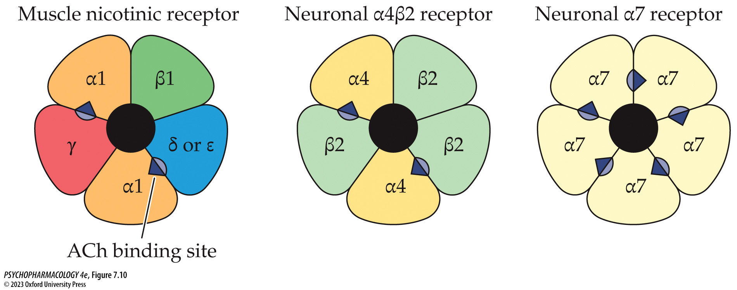
FIGURE 7.10 Three common types of nicotinic ACh receptors
Notes:
FIGURE 7.10 Three common types of nicotinic ACh receptors
The muscle nicotinic receptor shown on the left is designated as (α1)₂(β1)(γ)(δ/ε), which means that each receptor complex contains two α1 subunits, one β1 subunit, one γ subunit, and one δ or ε subunit. The γ, δ, and ε subunits each have only one form, which is why no numbering is needed in those cases. Nicotinic receptors in neurons are more complex because of the variety of α and β subunit combinations that have been detected in these cells. For simplicity, we are depicting here just two important kinds of neuronal nicotinic receptors found in the brain: (α4)₂(β2)₃ and (α7)₅. Note that the muscle and the (α4)₂(β2)₃ receptors have two ACh binding sites, whereas the (α7)₅ receptor has five ACh binding sites. Whether two or five such sites are present, all must be occupied by ACh or another agonist such as nicotine for the receptor channel to open.

Slide 32
Organization and Function of the Cholinergic System (8 of 15)
There are two acetylcholine receptor subtypes: nicotinic and muscarinic
Subunit composition determines key features of a receptor such as affinity of binding sites, ionic selectivity, allosteric binding sites, channel opening and closing kinetics
Ionotropic receptors can be closed, open, or desensitized; when desensitized, channel is closed and won’t open even if an agonist binds.
Prolonged exposure to an agonist enhances the rate of conversion to the desensitized state; can spontaneously resensitize
Notes:
Instructor Notes:

Slide 33
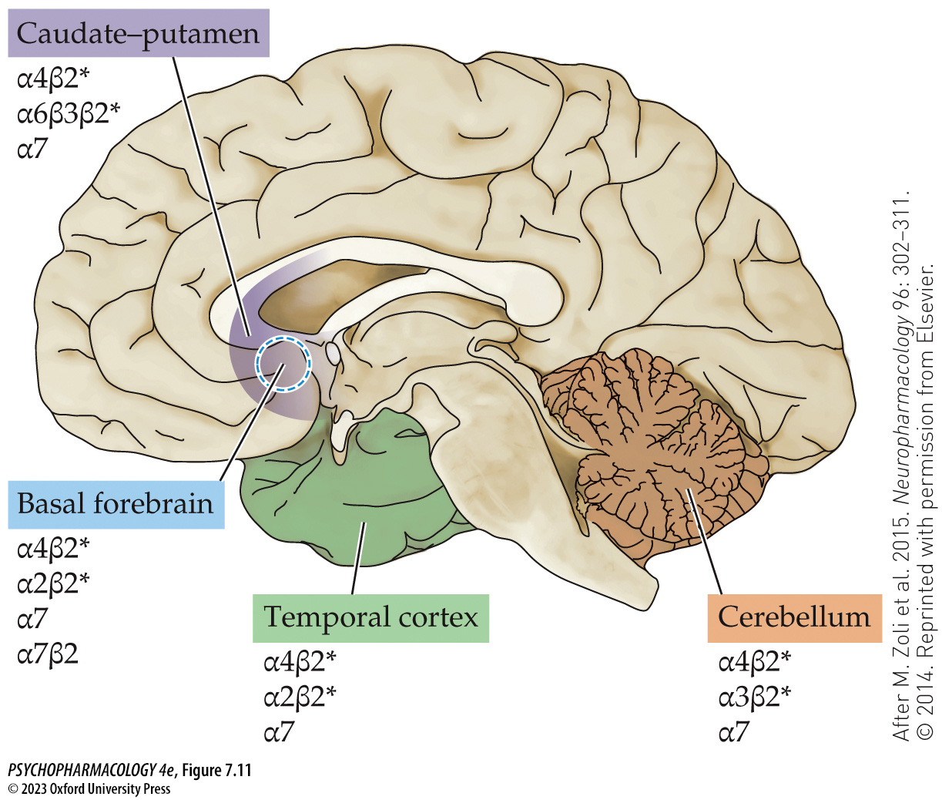
FIGURE 7.11 Composition of nicotinic receptor subtypes identified in selected areas of the human brain
Notes:
FIGURE 7.11 Composition of nicotinic receptor subtypes identified in selected areas of the human brain
Multiple receptor subtypes are found in each of the brain regions shown in the figure. All of the receptors shown with an asterisk (*) contain two α and two β subunits [e.g., (α4)₂(β2)₂ in the caudate–­putamen] that form the two agonist binding sites. The fifth subunit is either an α or a β that does not participate in agonist binding. The α7β2 receptor shown in the basal forebrain is a rare subtype that is thought to be expressed only in this brain area. (After M. Zoli et al. 2015. Neuropharmacology 96: 302–311. © 2014. Reprinted with permission from Elsevier.)

Slide 34
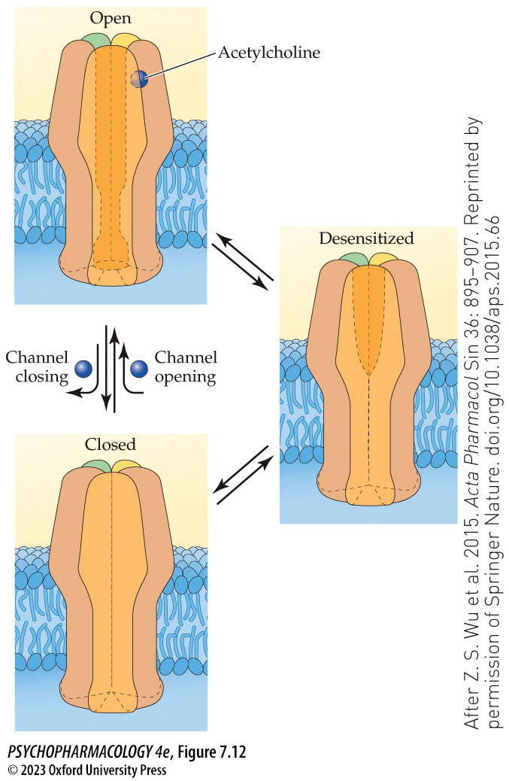
FIGURE 7.12 Functional states of the nicotinic ACh receptor
Notes:
FIGURE 7.12 Functional states of the nicotinic ACh receptor
The receptor can exist in three different states: open, closed, and desensitized. A channel in the closed state can be opened by agonist binding (note that only a single agonist binding site is shown for the sake of simplicity). Dissociation of agonist from its binding site can return the receptor to the closed state. However, receptor complexes can also move between open or closed states to a state of desensitization, in which the receptor neither permits ion flow nor can be activated by agonist binding. The only way a desensitized receptor can be activated is to be resensitized into either a closed or open state. (After Z. S. Wu et al. 2015. Acta Pharmacol Sin 36: 895–907. Reprinted by permission of Springer Nature. doi.org/10.1038/aps.2015.66)

Slide 35
Organization and Function of the Cholinergic System (9 of 15)
There are two acetylcholine receptor subtypes: nicotinic and muscarinic
Even with continuous agonist exposure, not all receptors are desensitized, and they produce a persistent depolarization of the cell membrane.
Depolarization block occurs: resting potential of the membrane is lost, and the cell cannot be excited until agonist is removed and membrane repolarized.
Notes:
Instructor Notes:
Succinylcholine (suxamethonium) powerful muscle relaxant; resistant to breakdown by AChE; thus it continuously stimulates the nAChRs and induces a depolarization block of the muscle cells.

Slide 36
Organization and Function of the Cholinergic System (10 of 15)
There are two acetylcholine receptor subtypes: nicotinic and muscarinic
Mecamylamine (Inversine): antagonist at neuronal nAChRs in the CNS and autonomic ganglia; antihypertensive agent, no longer used.
D-tubocurarine: antagonist of muscle nAChRs; paralyzing active ingredient of curare
Neonicotinoids such as imidacloprid, acetamiprid, and thiacloprid: receptor agonists selective for insect nAChRs; absorbed and distributed throughout treated plants; probably harms beneficial insects as well as crop pests.
Notes:
Instructor Notes:

Slide 37
Organization and Function of the Cholinergic System (11 of 15)
There are two acetylcholine receptor subtypes: nicotinic and muscarinic
Muscarinic receptors are metabotropic – operate via second messengers
Five subtypes: M₁, M₃, and M₅ activate the phosphoinositide second-messenger system (excitatory)
M₂ and M₄ inhibit cAMP synthesis, stimulate K⁺ channel opening, and inhibit nerve terminal Ca²⁺ channel opening (inhibitory)
Notes:
Instructor Notes:

Slide 38
Organization and Function of the Cholinergic System (12 of 15)
There are two acetylcholine receptor subtypes: nicotinic and muscarinic
Muscarinic receptors in the neocortex and hippocampus play an important role in the cognitive effects of Ach
Muscarinic receptors in the striatum are involved in motor function.
M₅ in the brain is expressed primarily in the hippocampus, hypothalamus, and midbrain DA areas; may have a role in drug reinforcement
Notes:
Instructor Notes:

Slide 39
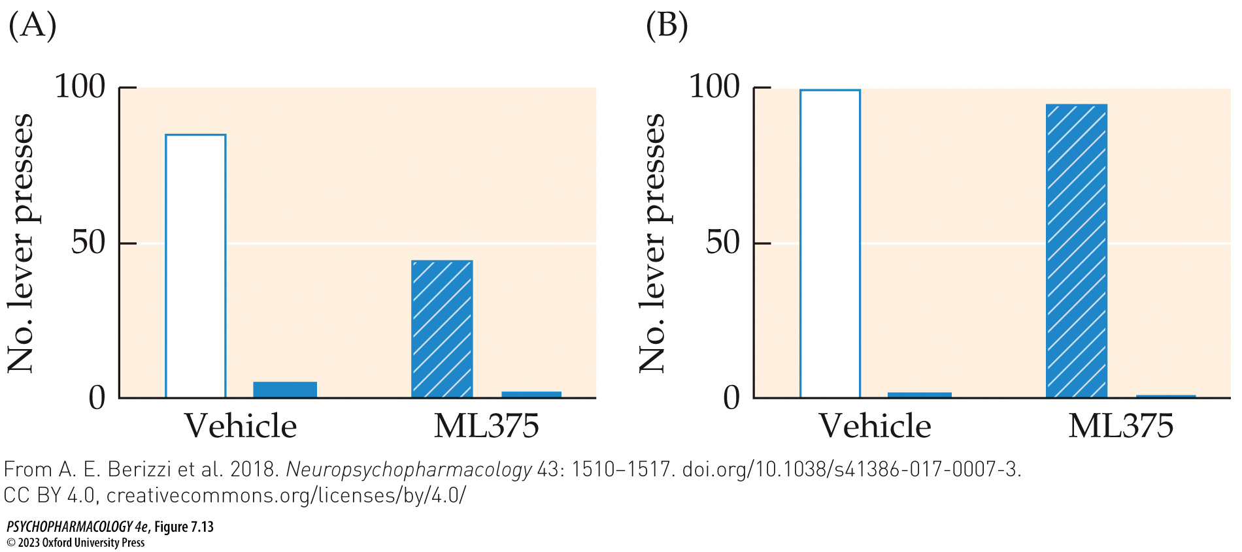
FIGURE 7.13 Administration of an M₅ muscarinic receptor negative allosteric modulator reduces voluntary ethanol consumption in iP rats
Notes:
FIGURE 7.13 Administration of an M₅ muscarinic receptor negative allosteric modulator reduces voluntary ethanol consumption in iP rats
Male iP rats (a strain of animals genetically selected to consume ethanol voluntarily) were trained to press a lever for a 10% ethanol/water solution reinforcer. A second lever in the chamber delivered a water-only solution instead. A separate set of learning trials was conducted using a sucrose (sugar) solution as the re­inforcer. After the animals had been trained on these tasks, they were given test trials with either ethanol or sucrose reinforcement after being given either the M₅ receptor negative allosteric modulator ML375 (30 mg/kg, injected IP three times at 27, 11, and 3 hours before testing) or the drug vehicle. (A) In the ethanol test, ML375 pretreatment significantly reduced the number of responses on the ethanol lever (open vs. striped bars) but had no effect on the small number of responses on the lever that delivered water (solid bars). (B) In contrast to the ethanol results, ML375 had no effect on responding for sucrose reinforcement. (From A. E. Berizzi et al. 2018. Neuropsychopharmacology 43: 1510–1517. doi.org/10.1038/s41386-017-0007-3. CC BY 4.0, creativecommons.org/licenses/by/4.0/)

Slide 40
Organization and Function of the Cholinergic System (13 of 15)
There are two acetylcholine receptor subtypes: nicotinic and muscarinic
Outside the brain, muscarinic receptors are found in cardiac and smooth muscle; activated by ACh released from parasympathetic postganglionic fibers
Drugs used to treat many psychiatric disorders block peripheral muscarinic receptors, especially in secretory glands; causes dry mouth effect
Notes:
Instructor Notes:

Slide 41
Organization and Function of the Cholinergic System (14 of 15)
There are two acetylcholine receptor subtypes: nicotinic and muscarinic
Naturally occurring muscarinic receptor agonists: muscarine, locarpine, arecoline (parasympathomimetic agents); mimic effects of parasympathetic activation; high doses can be fatal.
Muscarinic receptor antagonists inhibit parasympathetic action (parasympatholytic agents): atropine, scopolamine; found in henbane and deadly nightshade. Some have medical uses, such as atropine for dilating pupils
Notes:
Instructor Notes:
Muscarine: from Amanita muscaria mushrooms
Pilocarpine: from the leaves of the South American shrub Pilocarpus jaborandi
Arecoline: found in the seeds of the betel nut palm Areca catechu.

Slide 42
Organization and Function of the Cholinergic System (15 of 15)
CLICKER QUESTION 2
What is the active ingredient in curare?
Muscle nAChRs antagonist
Neuronal nAChRs antagonist
Muscarinic receptor agonist
AChE inhibitor
Notes:
Instructor Notes:
Correct answer: a

Slide 43
Review of Learning Objectives (2 of 2)
7.2.1 Identify the locations of cholinergic neurons in both the peripheral nervous system and the brain.
7.2.2 Discuss evidence for a role of various cholinergic systems in (a) motor control, including abnormalities in motor control in Parkinson’s disease, (b) memory encoding, (c) sustained attention, and (d) drug reward and reinforcement.
7.2.3 (a) Identify and characterize the two major cholinergic receptor subtypes, including their subunit structure (where relevant) and signaling mechanisms, (b) discuss the major behavioral functions of cholinergic receptors, and (c) list the major agonists and antagonists at these receptors and their behavioral or physiological effects.
7.2.4 Describe the three different states of nicotinic receptors and how they are regulated.

